Slide 1
CHITKARA BUSINESS SCHOOL
AI in Digital Wealth Management
A Robo-Advisory Case Study — Scripbox
STUDENT Abhay Trehan(2520992506), Kartik Juneja(2520992649),Harry chalana(2520992611),Arush(2520992549)
Hardik gagneja (2520992606) , Gurkimat singh(2520992600)
COURSE Ai & ML
01

Slide 2
COMPANY OVERVIEW
Scripbox — Digital Wealth Management, India
Scripbox is an online investment platform that helps everyday Indians save, invest and grow their money through curated mutual funds and goal-based financial plans — combining human advisory expertise with algorithm-driven fund selection.
INDUSTRY CONTEXT
India's Digital
Wealth-Tech Boom
Who it serves
Rising incomes, smartphone-first investors and SEBI-regulated robo-advisory are pushing mutual-fund platforms to automate advice at scale — while keeping it personal, transparent and compliant.
Salaried professionals, first-time investors and families across urban India
What it offers
SIPs, mutual fund portfolios, retirement, child-education and wealth-goal plans
How it competes
Simplicity + low-cost, data-backed fund curation instead of manual, fee-heavy advisory
02

Slide 3
BUSINESS PROBLEM
One Advisor Can't Personally Profile Every Client
As Scripbox scales to lakhs of investors, manually interviewing each client to judge risk appetite and manually comparing hundreds of mutual funds doesn't scale — and produces inconsistent advice from person to person.
1
2
3
4
Slow onboarding
Inconsistent risk-tagging
Fund overload
Poor retention
Manual questionnaires and advisor calls delay a client's first investment
Two advisors can rate the same client differently
1,000+ mutual funds make manual comparison impractical for clients
Mismatched, generic advice causes clients to disengage or exit
03

Slide 4
DATA REQUIRED
Two Data Streams Feed the AI System
CLIENT / ONBOARDING DATA
MUTUAL FUND DATA
Age, income & number of dependents
Fund category (Large / Mid / Small Cap, Debt, Hybrid)
Monthly investable surplus
1-, 3- and 5-year returns
Existing investments held
Expense ratio & standard deviation (cost / risk)
Investment horizon (years)
Sharpe ratio (risk-adjusted return)
Reaction to a past market drop (behavioural signal)
Fund rating
Note: real customer/fund data isn't public — the model here is demonstrated on synthetic data built to the same structure.
04

Slide 5
AI / ML SOLUTION
Two Models Working Together
CLASSIFICATION — RANDOM FOREST
MULTI-FACTOR WEIGHTED SCORING
Risk Profiling
Fund Ranking
Learns from client onboarding data to predict whether a client is Conservative, Moderate or Aggressive — replacing manual questionnaire scoring with a consistent, data-driven decision.
Scores and ranks every mutual fund on a weighted composite of returns, risk, cost and quality — a lighter version of the ~25-factor approach used by real robo-advisors.
WHY IT FITS
WHY IT FITS
Handles mixed numeric features well, resists noise, and gives explainable feature-importance scores — important for compliance.
Transparent formula (not a black box) — every weight can be shown and justified to a client or regulator.
05

Slide 6
HOW THE AI SOLUTION WORKS
From Client Data to a Confident Investment Decision
Business Data
→
AI / ML System
→
Prediction
→
Business Action
→
Business Outcome
Client onboarding info + fund performance data
Random Forest classifier + weighted scoring engine
Risk profile (e.g. "Moderate") + ranked fund shortlist
Platform matches shortlisted funds to the client
Client invests via SIP with a projected wealth goal
The Random Forest model predicts the client's risk category; the scoring engine independently ranks funds. The platform then combines both to shortlist funds matching that client's risk profile — turning raw data into a specific, explainable recommendation.
SAMPLE CLIENT (from the demo model)
Age 29 · ₹90,000/month income · 15-year horizon · ₹25,000/month SIP → Predicted profile: Moderate → Top funds: Hybrid & Large Cap
06

Slide 7
BUSINESS IMPACT
What This Automation Is Worth to Scripbox
✓
✓
✓
Faster onboarding
Consistent advice
Personalised fit
Risk profiling happens in seconds, not a phone call
Every client is scored the same objective way
Fund shortlist matches each client's real risk appetite
✓
✓
✓
Client trust
Scales cheaply
Better retention
SIP wealth-projection makes the plan feel concrete, not abstract
One model can profile lakhs of clients, not a large advisory team
Relevant recommendations reduce drop-off after onboarding
07

Slide 8
RISKS, ETHICS & RESPONSIBLE AI
Automation Earns Trust Only With Safeguards
Bias
Transparency
Human oversight
Risk labels must be audited across age/income groups so profiling doesn't skew unfairly
Feature importance & scoring weights are shown to clients/advisors, not hidden
SEBI requires a human-reviewable audit trail — the model supports, not replaces, advisor sign-off
Data privacy
Model risk
Financial & behavioural data is sensitive — needs encryption, access control, consent
Return assumptions are projections, not guarantees — mis-set expectations are a real regulatory risk
08

Slide 9
AI TOOLS & PROMPTS USED
How We Used Generative AI for Research
ChatGPT
Claude
Perplexity
Understanding robo-advisory concepts & structuring the case study
Comparing risk-profiling approaches and building this project
Finding sources on Scripbox and India's wealth-tech industry
EXAMPLE RESEARCH PROMPT
“Explain how robo-advisory platforms in India, such as Scripbox, use AI/ML for client risk profiling and mutual-fund recommendation. Include the ML technique used, business benefits, risks, and reliable sources.”
Used to scope the topic, get an accurate business-flow vocabulary, and identify what a real robo-advisor's AI/ML architecture typically includes — later verified against public sources.
09

Slide 10
PROMPT IMPROVEMENT & AI EVALUATION
From a Generic Question to a Usable Answer
BASIC PROMPT
IMPROVED PROMPT
“Tell me about robo-advisors in India.”
“Act as a fintech analyst. Explain how Scripbox uses AI/ML for risk profiling and fund recommendation — the specific technique, business benefits, risks, and cite reliable sources.”
Result: broad, generic overview — no specific ML technique, no business metrics, no sources.
Result: specific, structured, source-backed answer we could actually verify and use.
WHY THE IMPROVED PROMPT WORKED BETTER
Gave the AI a role (“fintech analyst”) to shape tone and depth
Named the exact company and outcome needed, not a vague topic
Explicitly asked for sources — forcing verifiable, checkable output
10

Slide 11
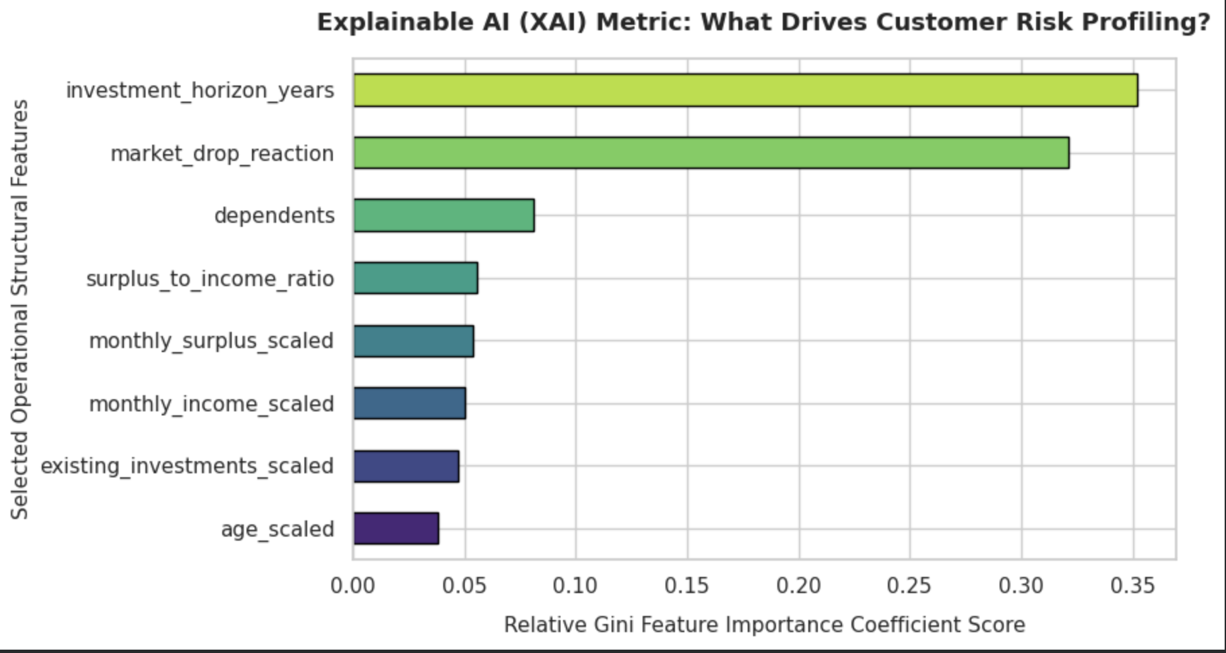
RECOMMENDATIONS & CONCLUSION
What the XAI Feature-Importance Chart Tells Us to Do Next
1
Capture investment horizon & market-drop reaction first — they drive ~67% of the risk score
2
Build the explainability dashboard around these two dominant drivers
3
Audit horizon & reaction inputs for hidden age, income or gender bias
4
Keep mandatory advisor sign-off — two features carry most of the weight
5
A/B test a shorter onboarding flow built on just these two questions
XAI output: Gini feature-importance by driver
CONCLUSION
The XAI feature-importance chart shows risk profiling is really driven by two signals — investment horizon and reaction to a past market drop (~67% combined). That concentration makes the model easy to explain, but it also means Scripbox must protect the quality of just those two inputs and keep a human advisor accountable for the final call.
11

Slide 12
LEARNING REFLECTION
What We Took Away From This Project
Business + AI together
Explainability matters
Prompting is a skill
A good AI solution starts from a clear business problem, not a model looking for a use case
In finance, a model must justify its decisions — accuracy alone isn't enough
Adding a role, specifics and “cite sources” turned vague AI answers into usable research
12

Slide 13
TEAM
Team GitHub Repositories
Individual repositories submitted by each team member for this project
GITHUB
GITHUB
GITHUB
Arush
Abhay Trehan
Harry Chalana
github.com/doomraarush-sudo
github.com/abhay2506bbafai25-web
github.com/chalanaharry-pixel
GITHUB
GITHUB
GITHUB
Hardik Gagneja
Kartik Juneja
Gurkimat Singh
github.com/hardik2606bbafai25-spec
github.com/junejakartik725-cell
github.com/gurkimat
13

